Slide 1
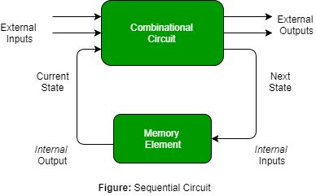
Unit 3
Sequential Logic Circuits 12M

Slide 2
Introduction
The digital systems in general are classified into two namely:
1. Combinational logic circuits
2. Sequential logic circuits.

Slide 3
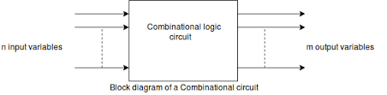
Combinational circuits :
Till now we have discussed only the combinational circuits
The output of a combinational circuit at any instant of time, depends only on the levels present at input terminals.
It does not depend on the past status of inputs.
The combinational circuits do not use any memory. Therefore the previous states of input does not have any effect on the present value of the circuit

Slide 4
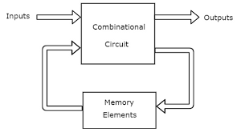
Sequential Circuits :
In the sequential circuit, the timing parameter also needs to be taken into consideration.
The output of a sequential circuit depends on the present time inputs, the previous output (past) and the sequence in which the inputs are applied.
In order to provide the previous input, a memory element is required as shown in the figure.

Slide 5
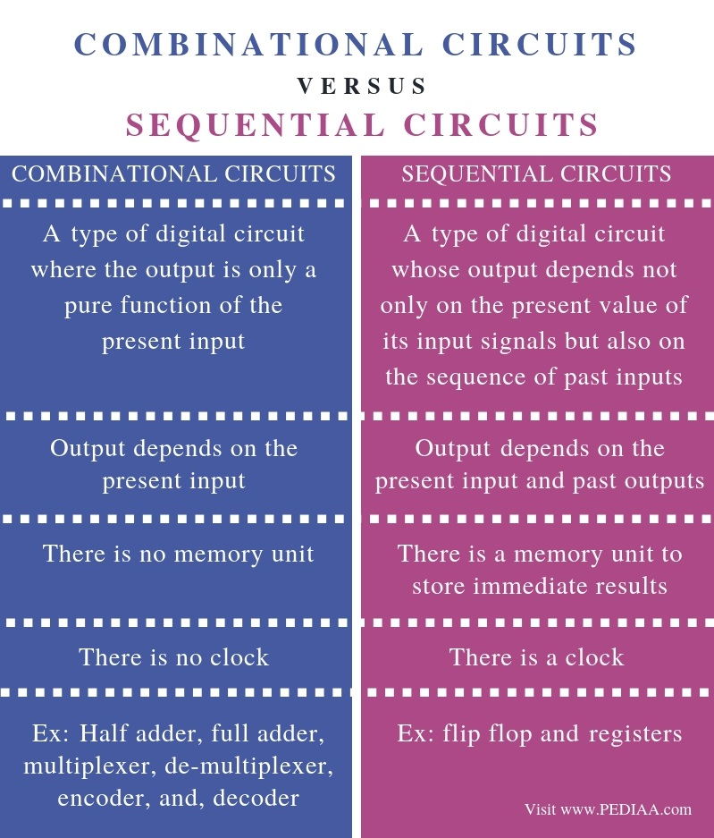
Comparison

Slide 6
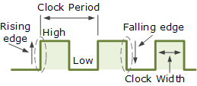
Clock Signal
The clock signal is a timing signal.
Every sequential signal will have this timing signal applied as an input signal.
Clock is a rectangular signal as shown in fig. with a duty cycle equal to 50%.means its ON time is equal to its OFF time.
The clock signal repeats itself after every T seconds.

Slide 7
Latch
Latch is a temporary storage device.
In (digital) electronics latching means that the signal "locked" in a certain state (zero or one) unless a clock or other control signal allows it to change

Slide 8
Flip-Flops
A flip-flop is a device which stores a single bit (binary digit) of data; one of its two states represents a "one" and the other represents a "zero".
Such data storage can be used for storage of state, and such a circuit is described as sequential logic in electronics.
Flip flop is formed using logic gates, which are in turn made of transistors.
Flip flop are basic building blocks in the memory of electronic devices.
Each flip flop can store one bit of data. These are also called as sequential logic circuits

Slide 9
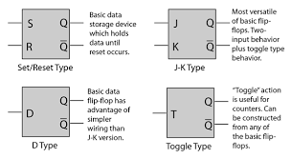

Slide 10
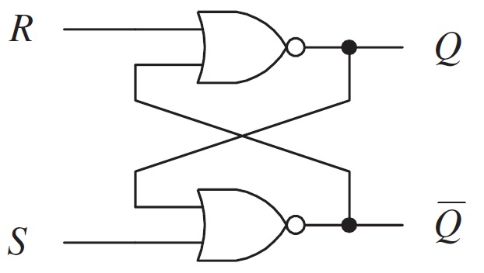
S-R Flip Flop
The SR flip flop is a 1-bit memory bistable device having two inputs, i.e., SET and RESET. The SET input 'S' set the device or produce the output 1, and the RESET input 'R' reset the device or produce the output 0. ... The SR flip flop stands for "Set-Reset" flip flop.
S | R | Q | Q+1
0 | 0 | 0
0 | 0 | 1
0 | 1 | 0
0 | 1 | 1
1 | 0 | 0
1 | 0 | 1
1 | 1 | 0
1 | 1 | 1
S | R | Q+1
0 | 0
0 | 1
1 | 0
1 | 1

Slide 11
Difference between Latch and Flip-flop:
Latches and flip flops both are basically the bistable elements.
As discussed earlier a latch has an enable input. As long as it is active, the latch output will keep changing according to the changes in its input. In other words latch is a level triggered flip flop.
But flip flop is a sequential circuit which generally samples its inputs and changes its outputs only at particular instants of time and not continuously.
The flip-flops are therefore said to be edge sensitive or edge triggered rather than being level triggered like latches.

Slide 12
Level Triggering: Explain different triggering methods used flop.
The latch or flip-flop circuits which respond to change in their inputs, only if their enable input (E) held at an active level which may be either HIGH or LOW level are called as level triggered latches or flip-flops.
Thus these circuits do not respond at the rising or falling edges of the clock. They only respond to the steady HIGH or LOW levels of the clock signal.

Slide 13
Types of Level Triggered Flip-flops :
There are two types of level triggered flip-flops :
1. Positive level triggered.
2. Negative level triggered.
Positive level triggered :
If the outputs of a flip-flop respond to the input changes, only when its clock inputs at HIGH (1) level, then it is called as the positive level triggered flip-flop.
Negative level triggered FF :
If the outputs of a flip-flop respond to the input changes, only when its clock input is at LOW (0) level, then it is called as the negative level triggered flip-flop.
Note: The level triggering is not used practically, due to some of its disadvantages.

Slide 14
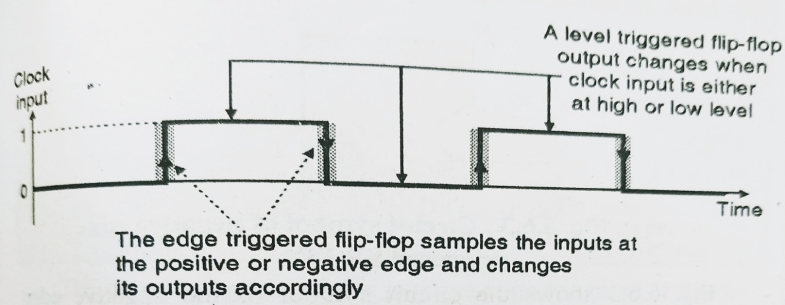
Edge triggered flip flops
The flip flops which change their outputs only corresponding to the positive (rising) or negative (falling) edge of the clock input are called edge triggered flip flops.
These flip-flops are therefore said to be edge sensitive or edge triggered rather and not level triggered.
The edge triggered flip flops do not respond to the steady state high or low level in the clock signal at all.

Slide 15
There are two types of edge triggered flip flops:
1. Positive edge triggered flip flops
2. Negative edge triggered flip flops.
Positive edge triggered flip flops will allow its outputs to change in response to its inputs only at the instants corresponding to the rising edges of clock (or positive spikes). Its outputs will not respond to change in inputs at any other instant of time.
Negative edge triggered flip flops will respond only to the negative going edges (or spikes) of the clock.
Note: All the practically used flip flops are edge triggered flip flops.

Slide 16
Clocked SR Flip Flops:

